Slide 1





Comic-Con Database Management System
Group 4:
Gagan Jain
Jiale Lyu
Yen Pang Chen
Jaswanth
Aishwar Govil

Slide 2
Introduction
Significance
Objective
Events like Comic-Con generate large amounts of diverse data requiring meticulous management.
Our aim is to present a database design capable of enhancing event management and organization.

Slide 3
Problem Statement
Handling vast amounts of data catering to registrations, scheduling, ticketing among many others is a big challenge.
Inefficient data storage and handling can lead to issues with data retrieval as well as data consistency and integrity.
A robust database management system is required that can handle not only efficient data storage for the event but also provide a way to access key information for data analytics.

Slide 4
Database Design Objectives
The key objectives are:
To maintain records and data associated with a Comic-Con event.
To implement relevant entities such as expo, attendee, payment, staff, sponsors and more.
To make use of various checks, constraints and encryption methods in order to maintain data integrity.
To provide key insights into the event’s statistics by using visualization tools to better help event organizers and stakeholders.

Slide 5
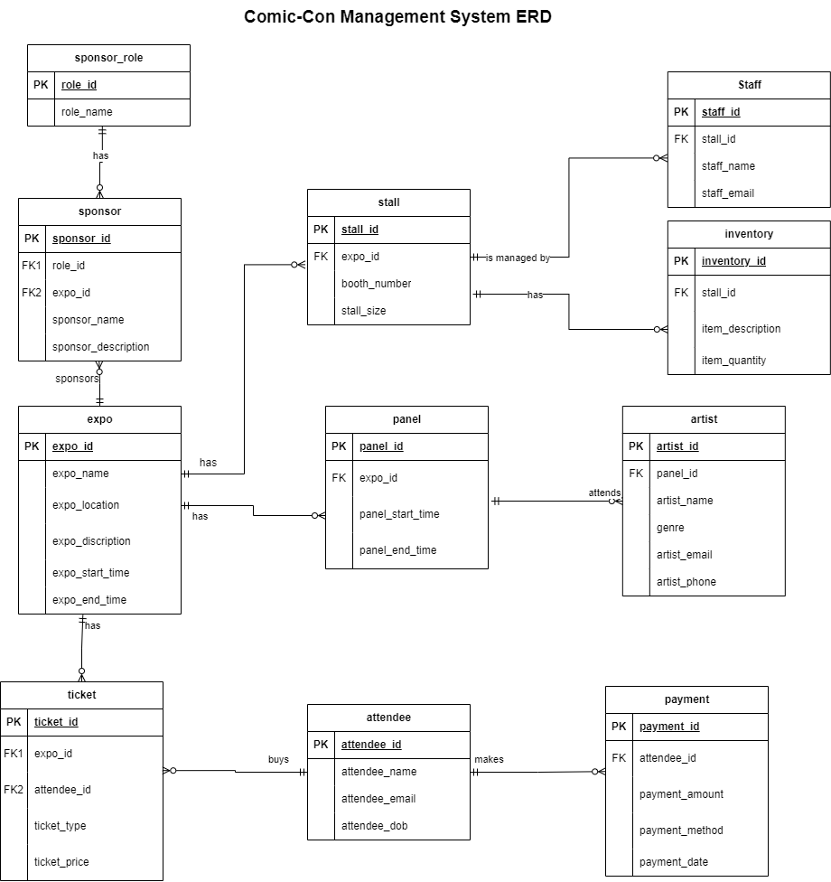
Entity Relationship Diagram (ERD)

Slide 6
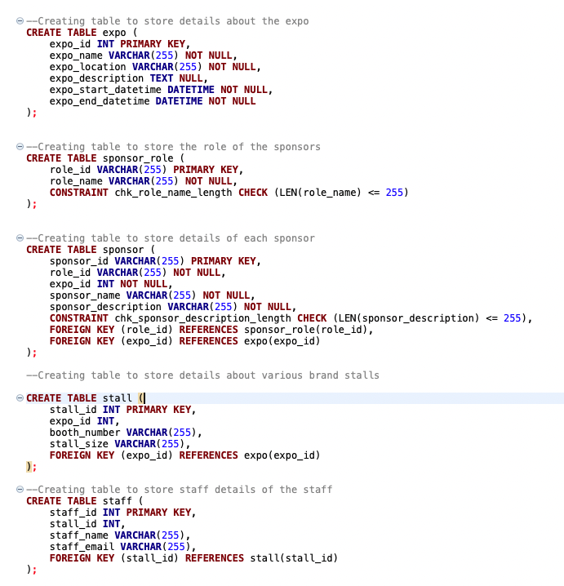
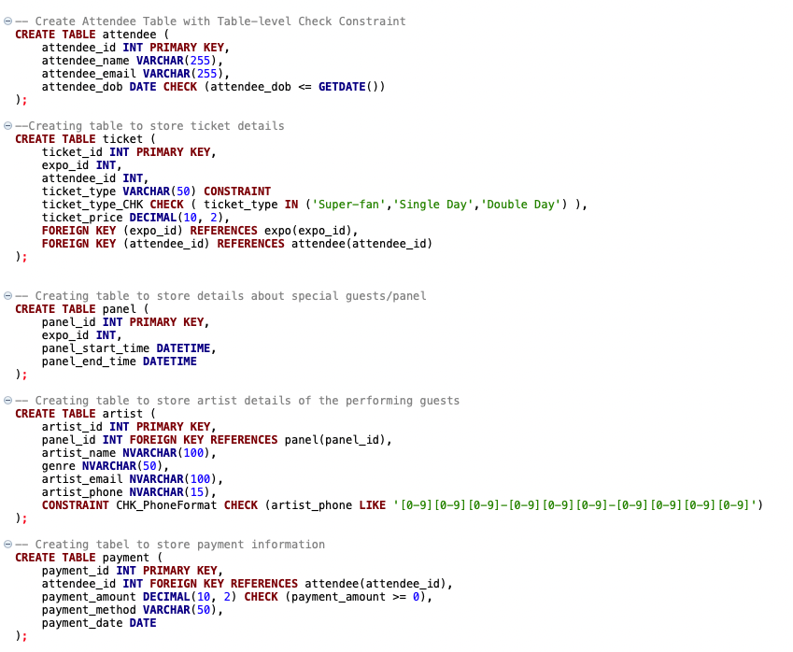
DDL Statements - Table Creation

Slide 7
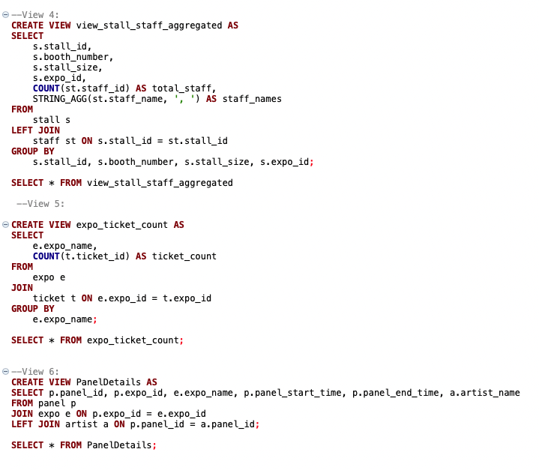
DDL Statements - Views
View_stall_staff_aggregated view:
This view provides a comprehensive view about the stall as well as the staff working on the stall
Expo_ticket_count view:
This view provides sales figures by aggregating the total number of tickets sold per day of the event
PanelDetails view:
This view provides a combined view of all the panel artists performing on each day of the event

Slide 8
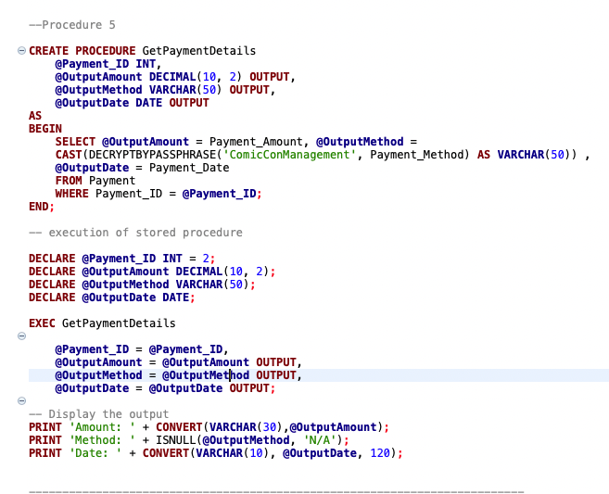
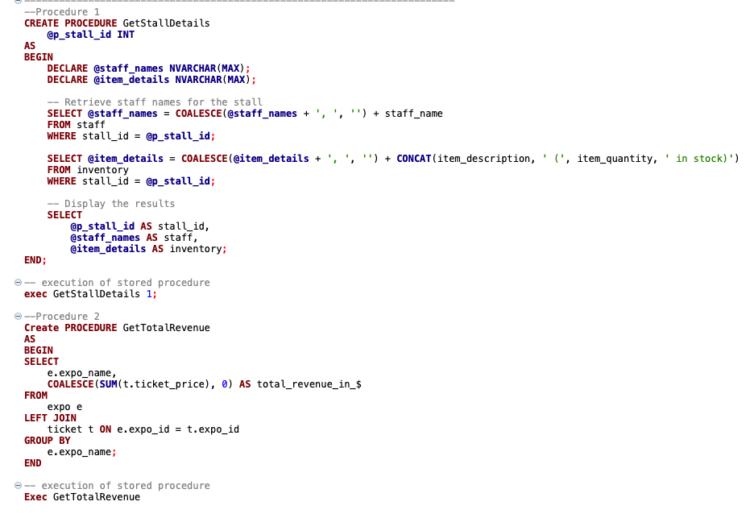
DDL Statements - Stored Procedures

Slide 9
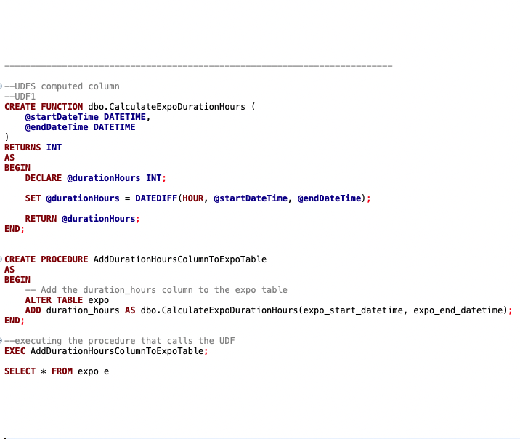
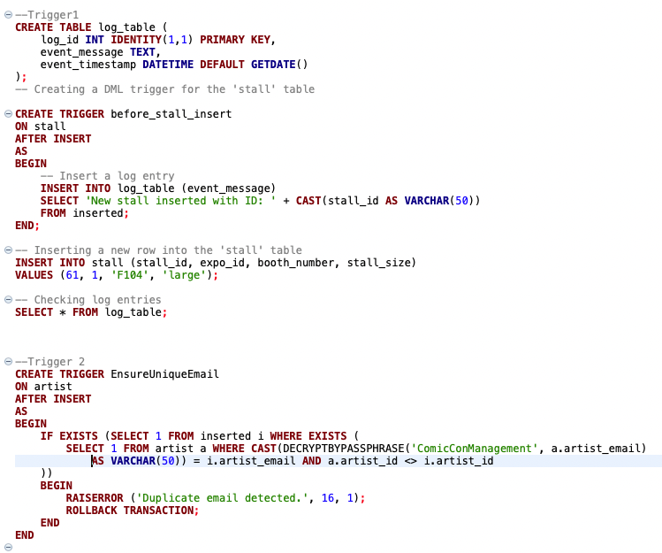
DDL Statements - Computed Columns/Triggers

Slide 10
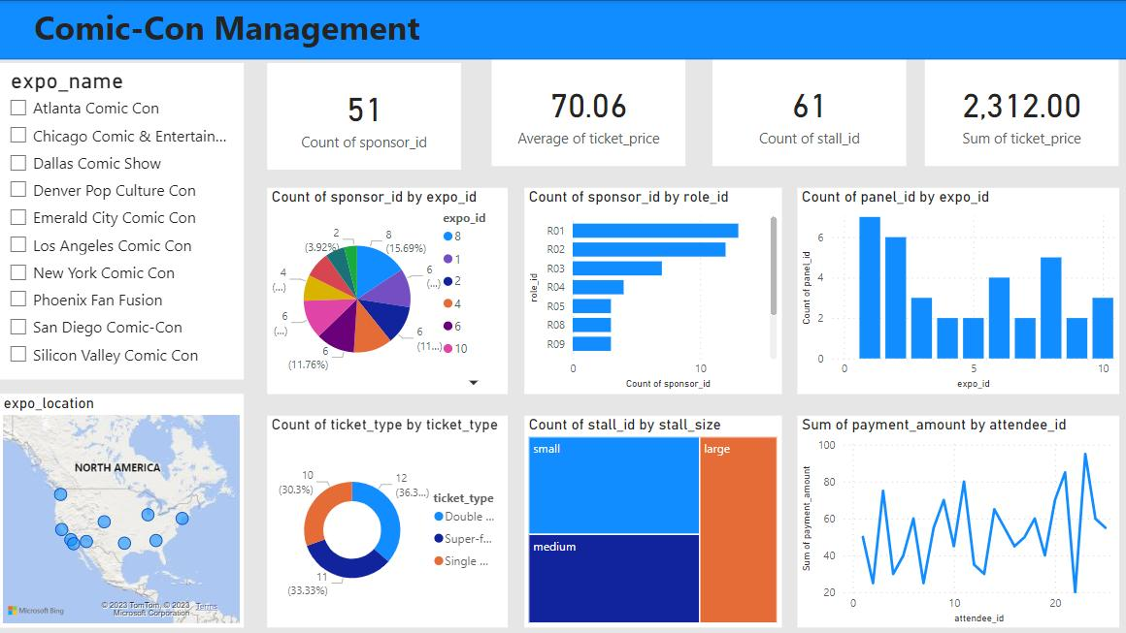
Data Visualization

Slide 11
Thank you!

